Slide 1
Modeling First Order Systems in Simulink
And Analyzing Step, Pulse and Ramp Responses
SOEN385
Control Systems and Applications

Slide 2
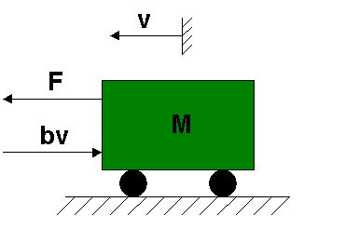
Free Body Diagram and System Equation
Simplified, first-order model of the motion of a car, assuming the car travels on a flat road:

Slide 3
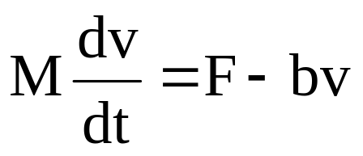
Free Body Diagram and System Equation
v is the horizontal velocity of the car (units of m/s).
F is the force created by the car's engine to propel it forward (units of N).
b is the damping coefficient for the car, which is dependent on wind resistance, wheel friction, ... (units of N*s/m), assuming the damping force to be proportional to the car's velocity.
M is the mass of the car (units of kg).
Writing Newton's Second Law for the horizontal direction gives:

Slide 4
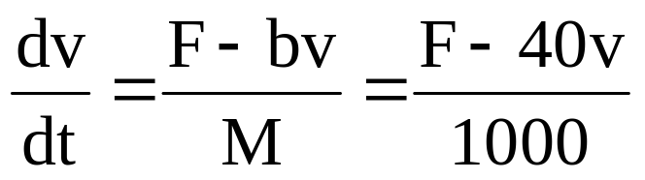
Building System Model
Assume M = 1000 kg and b = 40 N*sec/m
The system equation becomes:
Indicates that the car's acceleration (dv/dt) is equal to the sum of the forces acting on the car (F-bv) divided by the car's mass.

Slide 5
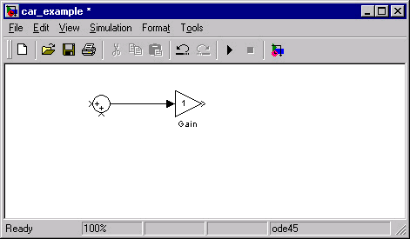
Building System Model
The Sum block needs to add the motor force F and subtract the damping force bv. Thus, double-click on this block and change the second "+" in the "List of signs" box into a "-".
Modify the Gain block so that it divides by the car's mass.

Slide 6
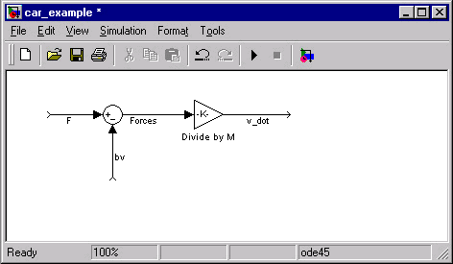
Building System Model
Add labels to the signals and blocks to keep our block diagram organized and easy to understand:

Slide 7
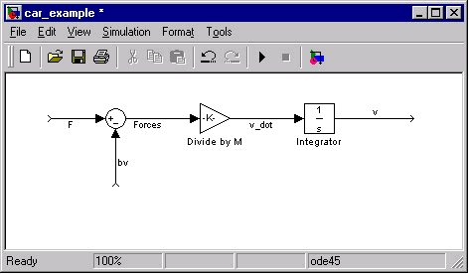
Building System Model
To relate the car's acceleration (v_dot in the Simulink model) to its velocity-dependent damping force, we will integrate the v_dot signal.

Slide 8
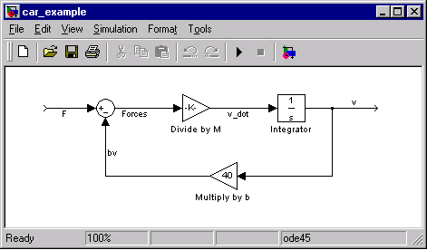
Building System Model
To obtain the damping force from the velocity, we need to branch the velocity signal and multiply it by the damping coefficient b.

Slide 9
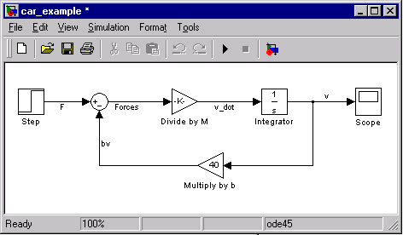
System Response to Step Inputs
Assume the car is initially at rest, and the engine applies a step input of F = 400 N at t = 0.

Slide 10
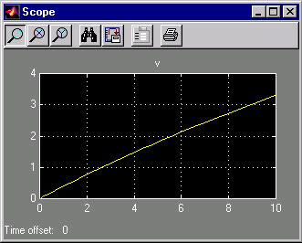
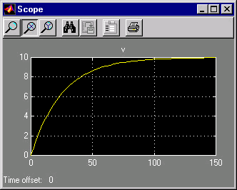
System Response to Step Inputs
Simulate the model
does not appear to show the velocity approaching a steady-state value
characteristic root s = -0.04, and thus the time constant is 25 and settling time is 4×25=100.

Slide 11
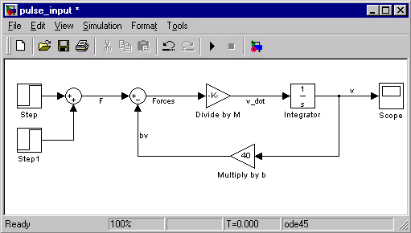
System Response to Pulse Inputs
This is approximately equivalent to the car's driver pressing and holding the gas pedal in a constant position for a specified period of time, and then releasing the pedal.

Slide 12
System Response to Pulse Inputs
To model the pulse input, the parameters for the original "Step" block can be left as they were before. Modify the "Step1" block parameters to the following:
Step Time = 100
Initial Value = 0
Final Value = -400
These settings enable the "Step1" block to cancel out the input from the "Step" block starting at t = 100.

Slide 13
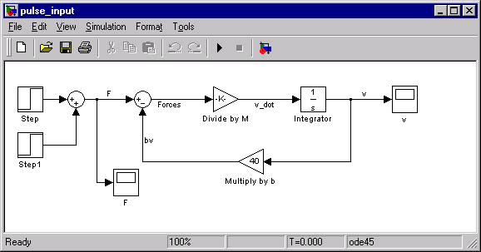
System Response to Pulse Inputs
Insert another scope to monitor the input of the system F

Slide 14
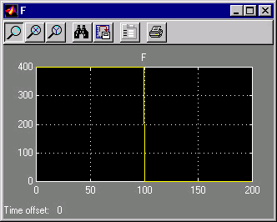
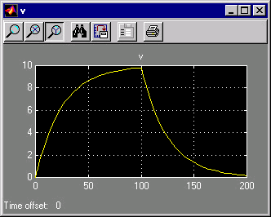
System Response to Pulse Inputs
Modify the simulation time to 200 seconds, then run the simulation.

Slide 15
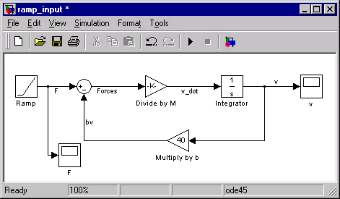
System Response to Ramp Inputs
This is approximately equivalent to the car's driver steadily depressing the gas pedal as the vehicle accelerates from a stop light.

Slide 16
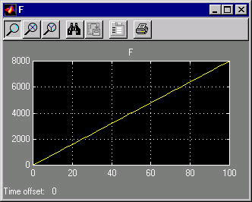
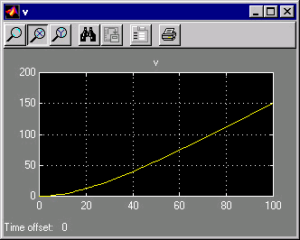
System Response to Ramp Inputs
Modify the Ramp block: set the Slope equal to 80 N/s. These settings cause the engine force to steadily increase 80 N every second, starting from F = 0 at t = 0.
Modify the simulation time to 200 seconds, then run the simulation.

Slide 17
System Response to Ramp Inputs
These plots show us that:
  If the input force of the engine F is increased steadily, the velocity of the car v will continue to rise, and thus does not approach a specific steady-state value.
  The velocity curve eventually settles into a straight line. So, the steady-state response to the ramp input is linear, and it has a positive slope.

Slide 18
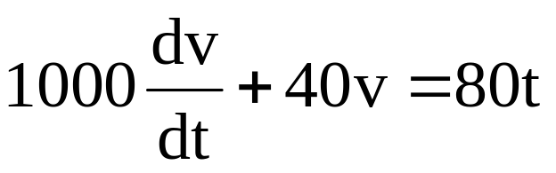
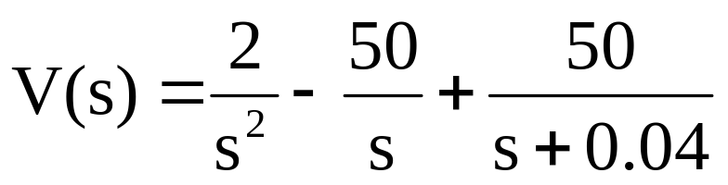
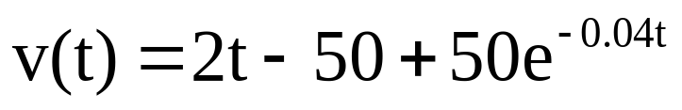
System Response to Ramp Inputs
Let's verify these results by solving the differential equation for the ramp input:
Taking the Laplace transform of this equation (with initial condition v(0) = 0) and solving for V(s) yields:
Converting back to time domain gives us the solution for v(t):

Slide 19
System Response to Ramp Inputs with Saturation
In reality, there is a maximum force that the car's engine is capable of producing, and thus a maximum velocity that the vehicle can attain, therefore F cannot take a value above this upper limit.
To make the simulation more realistic, we will apply a ramp input to our system with the restriction that the engine force F is not allowed to exceed 2000 N.

Slide 20
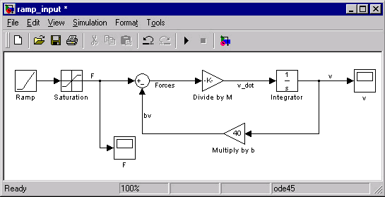
System Response to Ramp Inputs with Saturation

Slide 21
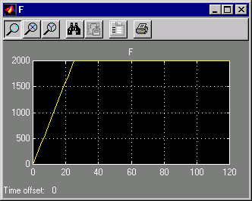
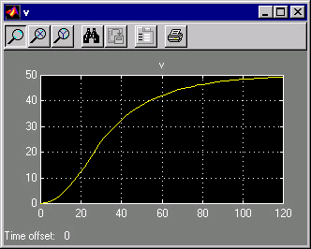
System Response to Ramp Inputs with Saturation

Slide 22
References
Simulink Tutorials
http://www.engin.umich.edu/group/ctm/working/mac/first_order/index.htm

